Slide 1


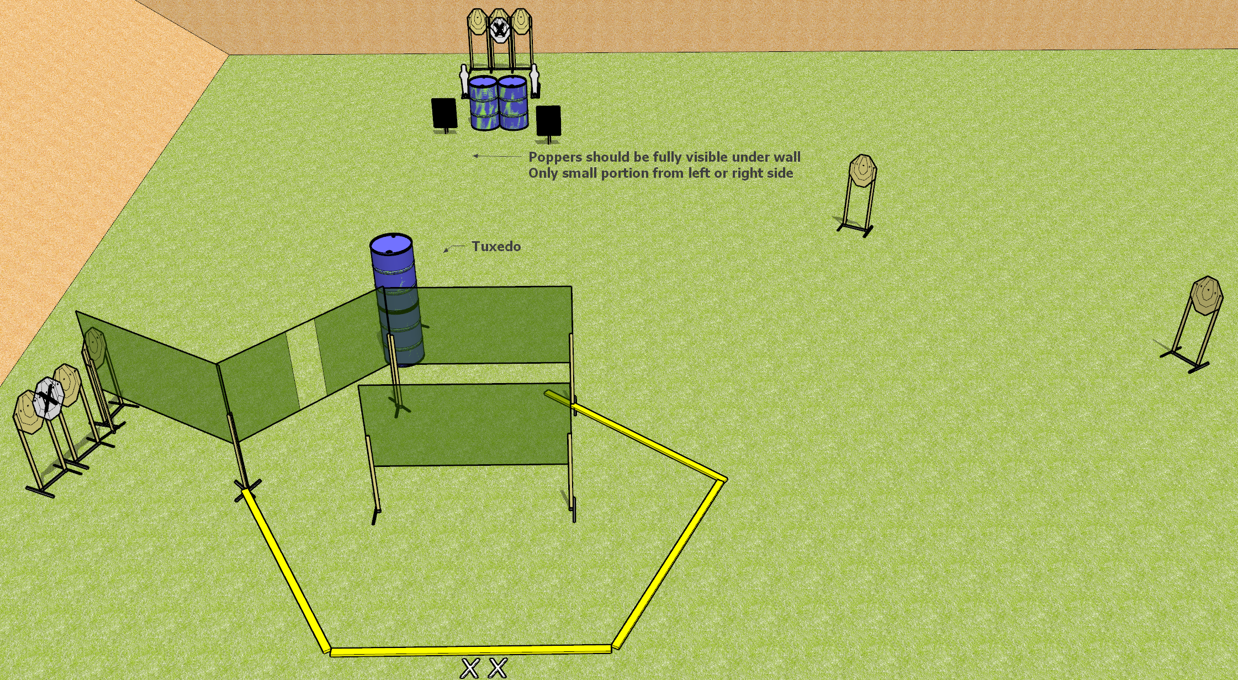
 | Dothan Gun Club – USPSA Match Do What You Want Course Designer : Drew Coleman
START POSITION : Standing with both feet on X’s. Hands relaxed at sides.
GUN READY CONDITION : Pistol unloaded and holstered. PCC unloaded, held with both hands, buttstock on belt pointed downrange. |  | SCORING: Comstock, 20 rounds TARGETS: 9 paper, 2 Steel SCORED HITS: Best 2 on paper, steel until down START-STOP: Audible, last shot RULES: Front wall in center is considered to be as constructed and shots may be fired from underneath.
STAGE PROCEDURE: Engage targets as they become available from within the fault lines

